Slide 1
Kinematics of Wheeled Robots

Slide 2
https://www.youtube.com/watch?v=giS41utjlbU

Slide 3
Wheeled Mobile Robots
robot can have one or more wheels that can provide
  steering (directional control)
  power (exert a force against the ground)
an ideal wheel is
  perfectly round (perimeter 2πr)
  moves in the direction perpendicular to its axis

Slide 4
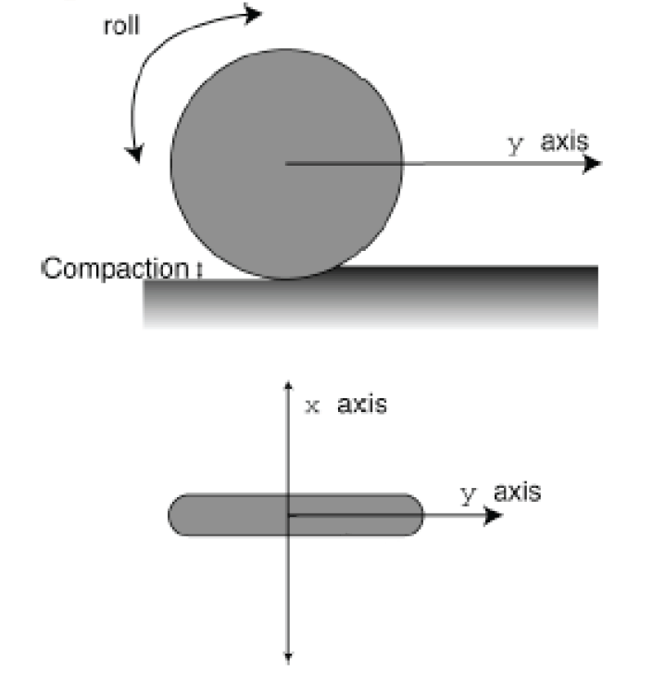
Wheel

Slide 5
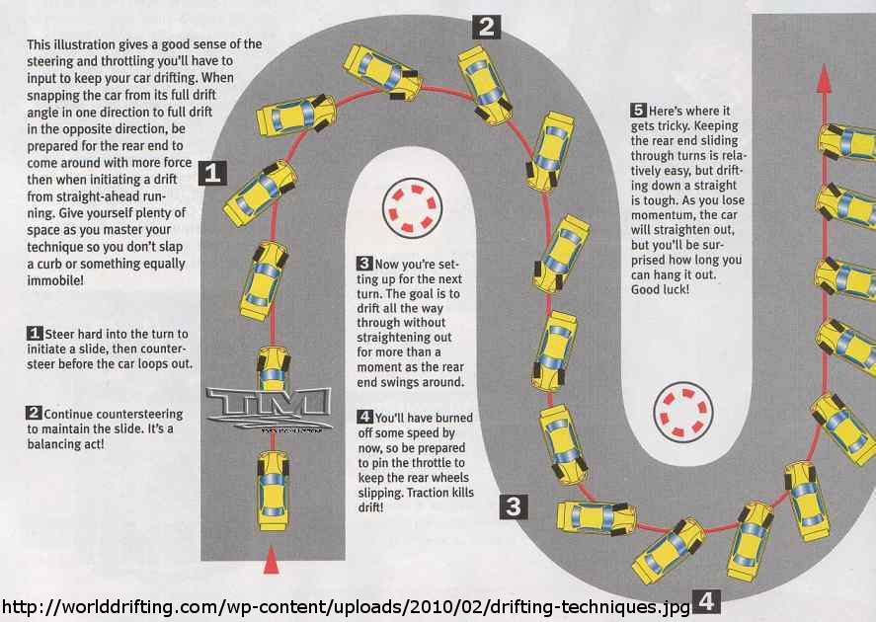
Deviations from Ideal

Slide 6
Instantaneous Center of Curvature
for smooth rolling motion, all wheels in ground contact must
  follow a circular path about a common axis of revolution
    each wheel must be pointing in its correct direction
  revolve with an angular velocity consistent with the motion of the robot
    each wheel must revolve at its correct speed

Slide 7
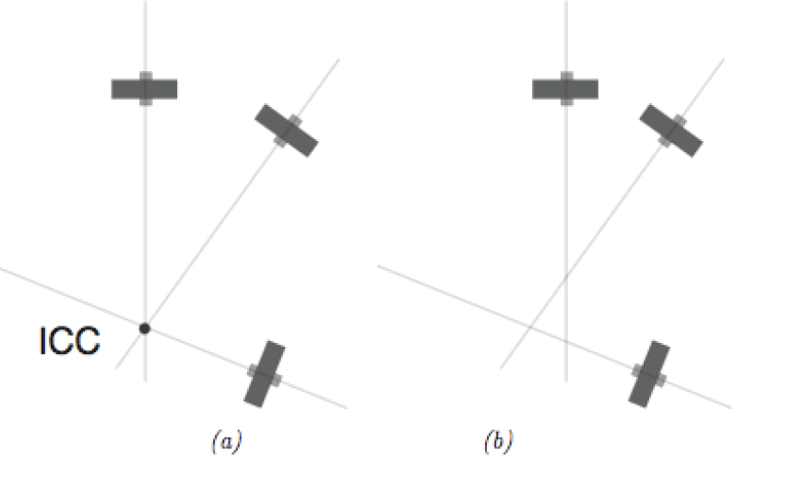
Instantaneous Center of Curvature
3 wheels with roll axes intersecting at a common point (the instantaneous
center of curvature, ICC). (b) No ICC exists. A robot having wheels shown in
can exhibit smooth rolling motion, whereas a robot with wheel arrangement
(b) cannot.

Slide 8
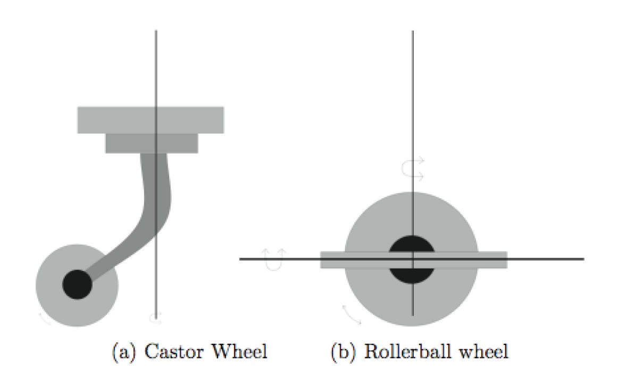
Castor Wheels
provide support but not steering nor propulsion

Slide 9
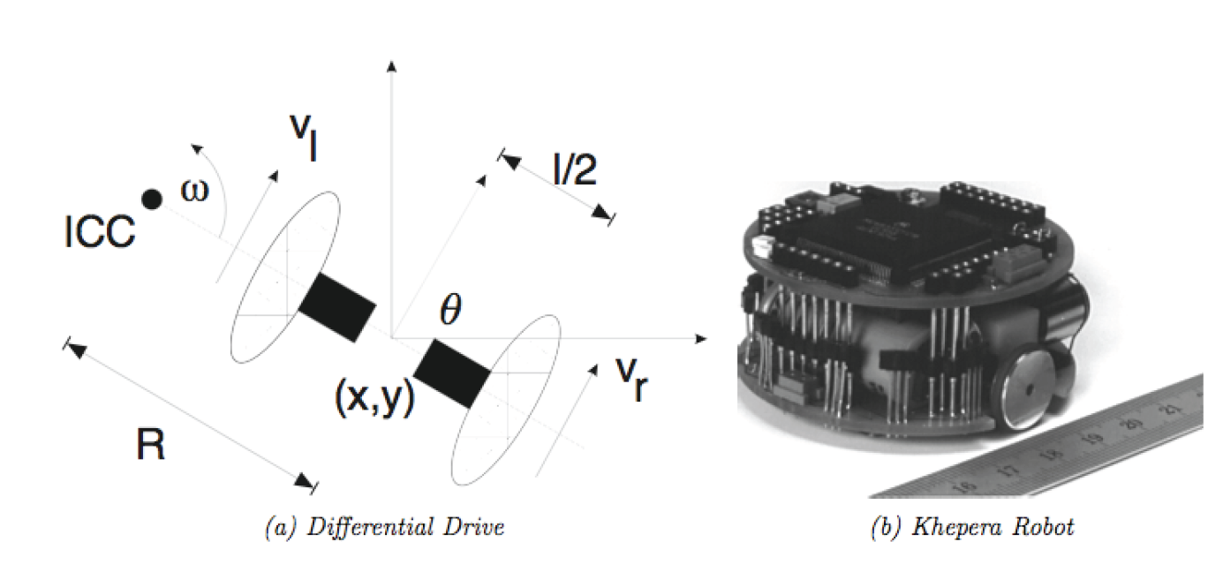
Differential Drive
two independently driven wheels mounted on a common axis

Slide 10

Differential Drive
angular velocity $ω$ about the ICC defines the wheel ground velocities $v_{r}$ and $v_{ℓ}$
distance between ICC and right wheel
distance between ICC and left wheel
https://opencurriculum.org/5481/circular-motion-linear-and-angular-speed/

Slide 11

Differential Drive
given the wheel ground velocities it is easy to solve for the radius, R, and angular velocity ω
interesting cases:
  $v_{ℓ}=v_{r}$
  $v_{ℓ}={−v}_{r}$

Slide 12
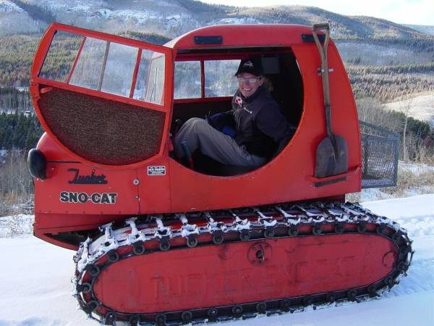
Tracked Vehicles
similar to differential drive but relies on ground slip or skid to change direction
  kinematics poorly determined by motion of treads
http://en.wikipedia.org/wiki/File:Tucker-Kitten-Variants.jpg

Slide 13
Steered Wheels: Bicycle

Slide 14
Steered Wheels: Bicycle
important to remember the assumptions in the kinematic model
  smooth rolling motion in the plane
does not capture all possible motions
  http://www.youtube.com/watch?v=Cj6ho1-G6tw&NR=1#t=0m25s

Slide 15
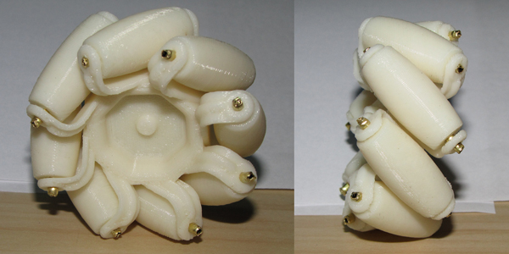
Mecanum Wheel
a normal wheel with rollers mounted on the circumference
https://www.youtube.com/watch?v=O7FbDy-gE70
https://www.youtube.com/watch?v=mUoftURFsxM
http://ftp.mi.fu-berlin.de/pub/Rojas/omniwheel/Diegel-Badve-Bright-Potgieter-Tlale.pdf
http://blog.makezine.com/archive/2010/04/3d-printable-mecanum-wheel.html

Slide 16
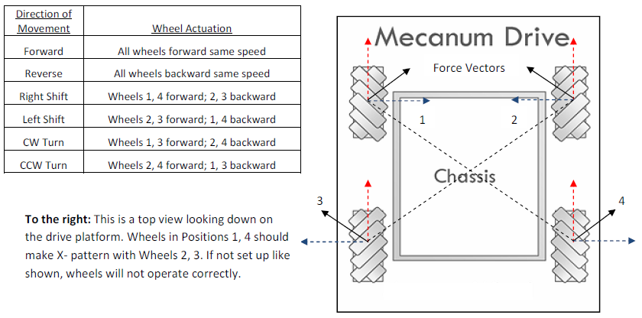
Mecanum Wheel
AndyMark Mecanum wheel specification sheet
http://d1pytrrjwm20z9.cloudfront.net/MecanumWheelSpecSheet.pdf

Slide 17
Forward Kinematics
serial manipulators
  given the joint variables, find the pose of the end-effector
mobile robot
  given the control variables as a function of time, find the pose of the robot
    for the differential drive the control variables are often taken to be the ground velocities of the left and right wheels
      it is important to note that the wheel velocities are needed as functions of time; a differential drive that moves forward and then turns right ends up in a very different position than one that turns right then moves forward!

Slide 18
Forward Kinematics
robot with pose [x y θ]^{T} moving with velocity V in a direction θ measured relative the x axis of {W}:
V
θ
{W}

Slide 19
Forward Kinematics
for a robot starting with pose [x₀ y₀ θ₀]^{T} moving with velocity V(t) in a direction θ(t) :
V
V sin θ
θ
V cos θ

Slide 20
Forward Kinematics
for differential drive:

Slide 21
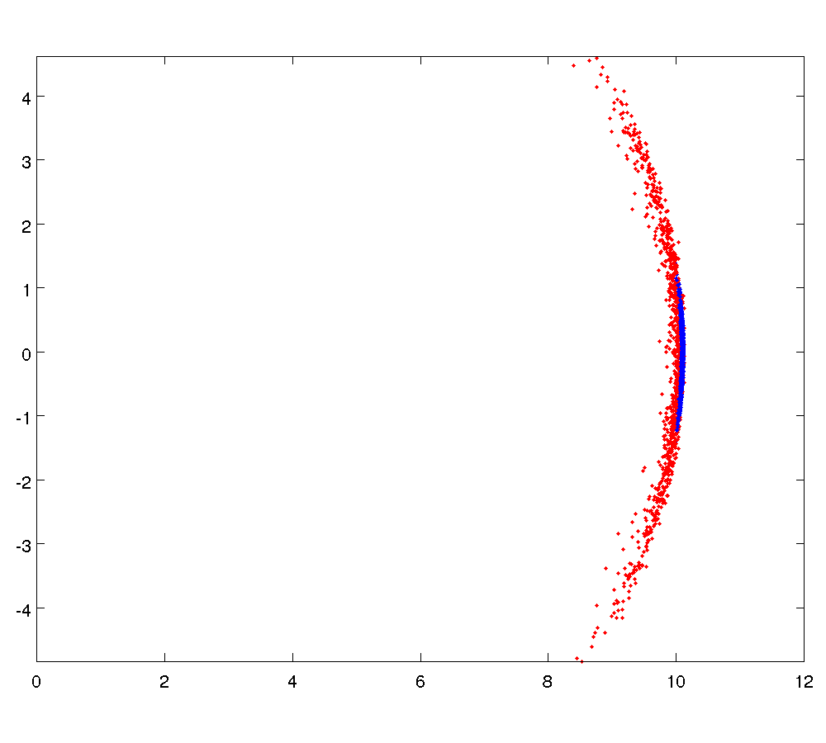
Sensitivity to Wheel Velocity
σ = 0.05
σ = 0.01

Slide 22
Sensitivity to Wheel Velocity
L = 0.2;
sigma = 0.05;
figure hold on
for i = 1:1000
vR = 1 + normrnd(0, sigma);
vL = 1 + normrnd(0, sigma);
theta = 0;
x = 0;
y = 0;
dt = 0.1;
for t = 0.1:dt:10
x = x + 0.5 * (vR + vL) * cos(theta) * dt;
y = y + 0.5 * (vR + vL) * sin(theta) * dt;
theta = theta + 1 / L * (vR - vL) * dt;
vR = 1 + normrnd(0, sigma);
vL = 1 + normrnd(0, sigma);
end
plot(x, y, 'b.');
end

Slide 23
Mobile Robot Forward Kinematics

Slide 24
Forward Kinematics : Differential Drive
what is the position of the ICC in {W}?
V
θ
{W}

Slide 25
Forward Kinematics : Differential Drive
V
θ
{W}

Slide 26
Forward Kinematics : Differential Drive
assuming smooth rolling motion at each point in time the differential drive is moving in a circular path centered on the ICC
  thus, for a small interval of time δt the change in pose can be computed as a rotation about the ICC
ICC
R
P(t+δt)
P(t)

Slide 27
Forward Kinematics : Differential Drive
computing the rotation about the ICC
  translate so that the ICC moves to the origin of {W}
  rotate about the origin of {W}
  translate back to the original ICC
ICC
R
P(t+δt)
P(t)

Slide 28
Forward Kinematics : Differential Drive
computing the rotation about the ICC
  translate so that the ICC moves to the origin of {W}
  rotate about the origin of {W}
  translate back to the original ICC

Slide 29
Forward Kinematics : Differential Drive
computing the rotation about the ICC
  translate so that the ICC moves to the origin of {W}
  rotate about the origin of {W}
  translate back to the original ICC
how much rotation over the time interval?
  angular velocity * elapsed time =

Slide 30
Forward Kinematics : Differential Drive
computing the rotation about the ICC
  translate so that the ICC moves to the origin of {W}
  rotate about the origin of {W}
  translate back to the original ICC

Slide 31
Forward Kinematics : Differential Drive
what about the orientation ?
  just add the rotation for the time interval
new pose
which can be written as

Slide 32
Forward Kinematics: Differential Drive
the previous equation is valid if
  i.e., if the differential drive is not travelling in a straight line
if then

Slide 33
Sensitivity to Wheel Velocity
σ = 0.05
σ = 0.01

Slide 34
Sensitivity to Wheel Velocity
given the forward kinematics of the differential drive it is easy to write a simulation of the motion
  we need a way to draw random numbers from a normal distribution
  in Matlab
    randn(n) returns an n-by-n matrix containing pseudorandom values drawn from the standard normal distribution
    see mvnrnd for random values from a multivariate normal distribution

Slide 35
Sensitivity to Wheel Velocity
POSE = []; % final pose of robot after each trial
sigma = 0.01; % noise standard deviation
L = 0.2; % distance between wheels
dt = 0.1; % time step
TRIALS = 1000; % number of trials
for trial = 1:TRIALS
end
-run each trial-
see next slide

Slide 36
Sensitivity to Wheel Velocity
vr = 1; % initial right-wheel velocity
vl = 1; % initial left-wheel velocity
pose = [0; 0; 0]; % initial pose of robot
for t = 0:dt:10
end
POSE = [POSE pose]; % record final pose after trial t
-move the robot one time step -
see next slide

Slide 37
Sensitivity to Wheel Velocity
theta = pose(3);
if vr == vl
pose = pose + [vr * cos(theta) * dt;
vr * sin(theta) * dt;
0];
else
omega = (vr – vl) / L;
R = (L / 2) * (vr + vl) / (vr – vl);
ICC = pose + [-R * sin(theta);
R * cos(theta);
0];
pose = rz(omega * dt) * (pose – ICC) + ICC +
[0; 0; omega * dt];
end
vr = 1 + sigma * randn(1);
vl = 1 + sigma * randn(1);

